Slide 1
Ferry: A P2P-Based Architecture for Content-Based Publish/Subscribe Services
Yingwu Zhu and Yiminh Hu
IEEE
Presenter: Kuan-Ru Peng (彭冠儒)
Date: 2008/06/12

Slide 2
Outline
Introduction
Related Work
Background : CHORD
System Design
Discussion
Alternative Design
Evaluation
Conclusion and Future Work

Slide 3




Introduction
What is “Content-Based Pub/Sub Model”

Slide 4
Introduction
Filtering Algorithms and Implementation for Very Fast Publish/Subscribe Services on P2P Network, F. Fabert 2001
  Scheme S = {A₁, A₂, …., A_{n} }
  Attribute A_{i} = { name, type, domain(min, max)}
  Event e = { A₁= c₁, A₂ = c₂, …., A_{n} = c_{n} }
Notes:
Fabert所提出來的這種方法，足以應付大量的訂閱、以及event的回應

Slide 5
Introduction
Motivation
  Content-based pub/sub systems
    Centralized
      All the subscriptions store on the server. (Ex: Elivin)
    Distributed
      Using routing trees to perform event delivery based on multicast techniques. (Ex: Siena)
  DHT-based pub/sub systems
    Peers cooperate in storing subscriptions and routing events to subscribers in a fully distributed manner.
Notes:
DHT-based的系統因著有量好的延伸性、容錯能力以及自我管理的功能，有有相當多的人在設計此累的系統

Slide 6
Introduction
Motivation(cont.)
  Limitation
    Nontrivial cost in tree construction and maintenance.
    Current DHT solutions (Scribe/Bayeux) don’t support content-based pub/sub services.
    Some solutions place restrictions on subscription.
    Most of them fail to address the load-balancing issue.
Notes:
1.在p2p的系統中，各個node會很自由的進入、離開
3. Not using Febert’s solution. 訂閱的表達能力，是區分content-based或topic-based的主要特色
4. 有些節點會得到不平等的待遇

Slide 7
Introduction
Goal
  Design novel subscription installation and management algorithms that facilitate the aggregation of event delivery messages.
  Propose one-hop subscription push and attribute partitioning.
  Propose an efficient and scalable event delivery algorithm that is virtually maintenance-free.
Notes:
將系統中要傳送的message減到最少，因為在傳送前就已經被篩選過了
用此兩種方式來滿足系統的 load balance的需求
利用DHT來建tree，不需要額外付出維護、建立的成本

Slide 8
Outline
Introduction
Related Work
Background : CHORD
System Design
Discussion
Alternative Design
Evaluation
Conclusion and Future Work

Slide 9
Related Work
Pub/sub systems
  Topic-based
    Join the groups containing the topic in which they are interested.
    (EX: ISIS, iBus)
  Content-based
    Allow subscribers to specify their interests.
    (EX: MEDYM)

Slide 10
Related Work
MEDYM most similar to Ferry.
  Using routing trees to deliver events to the subscribers based on multicast techniques.
    matcher:
    responsible for event matches the event to subscriptions and obtains a destination list of the matched subscribers.
  Diff:
    Ferry exploits the embedded trees inherent in the underlying DHT to deliver events.
Notes:
Diff: 由於使用DHT來建立embedded trees 所要付出的成本較少
另外還有舉出很多p2p based pub/sub system，大部分的問題都在前面提到，像是不支援content-based或是tree的維護成本過高，有些則是因為當參與的節點數量一多，設定、更新所要付出的成本太高

Slide 11
Related Work
Meghdoot
  Feature
    Subscriptions are stored in a zone according to the coordinate determined by event attribute values.
    Addressing on the load balance issue by zone splitting and zone replication.
  Limitation
    Overlay structure is determined by the pub/sub scheme.
    Overlay dimensionality is proportional to the number of event attributes.
Notes:
Feature:
根據Event的attribute來決定要該訂閱存在哪個地方的zone
利用zone的切割、複製來滿足load balance
Limitation:
系統覆蓋的結構是根據pub/sub的情境來決定的
覆蓋的範圍跟事件的屬性成比例

Slide 12
Outline
Introduction
Related Work
Background : CHORD
System Design
Discussion
Alternative Design
Evaluation
Conclusion and Future Work

Slide 13
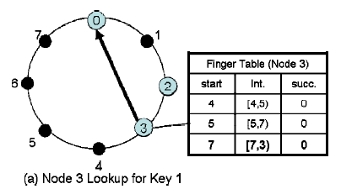
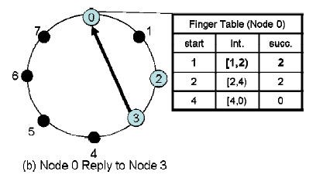
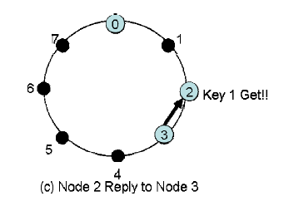
Background : CHORD

Slide 14
Outline
Introduction
Related Work
Background : CHORD
System Design
Discussion
Alternative Design
Evaluation
Conclusion and Future Work

Slide 15
System Design
Ferry
  Serve as a platform to host multiple pub/sub services
  Build on top of CHORD
    Applicable to other DHTS as Pastry, Tapestry
  Rendezvous Point(RP)
    The most immediate successors of k_{i} = h( A_{i} )
    Subscription (sid, p) :
      Ex: sid=1, p={A₁=c₁}

Slide 16
System Design
Ferry is based on four key mechanisms
  Subscription Installation
  Subscription Management
  Event Publication and Matching
  Event Delivery

Slide 17
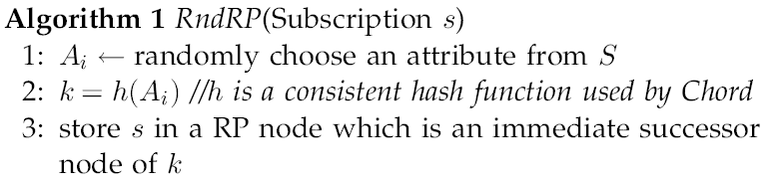
1. Subscription Installation
RndRP
Notes:
RndRP的好處是，當某個subscription非常熱門，他可以將這些訂閱分散在整個系統，但是在event的傳遞就會非常的沒有效率

Slide 18
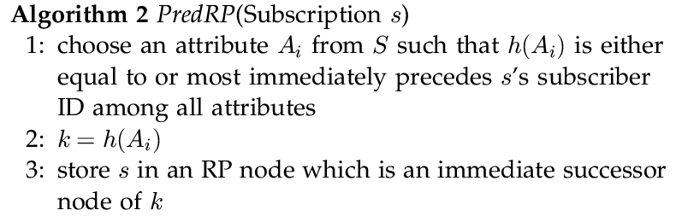
1. Subscription Installation
PredRP
Notes:
PredRP的基本概念是，將此訂閱紀錄存放在ID最靠近訂閱者ID的RP node上

Slide 19
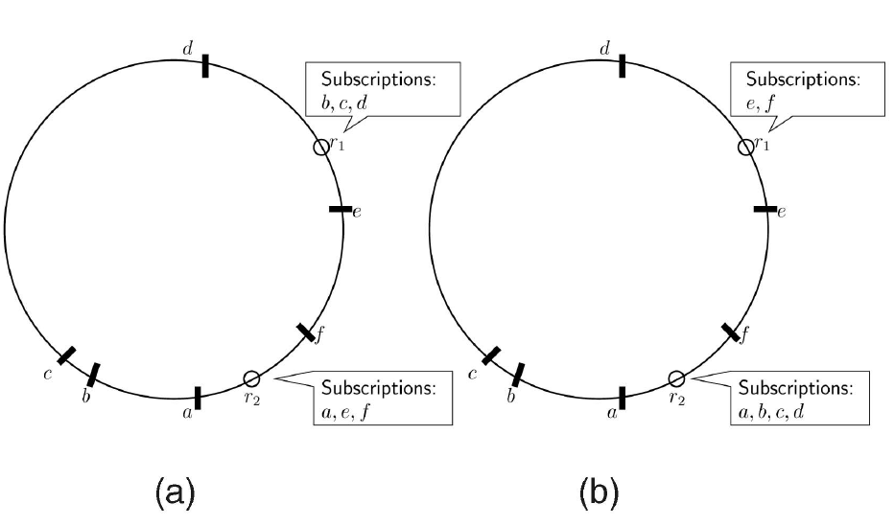
1. Subscription Installation
Register his/her interests to a RP node
  (a) RndRP (b)PredRP
Notes:
在這個步驟，目的是決定負責此subscription的RP node在哪裡，這個RP node當事件發生時，將會把event遞交給符合訂閱條件的訂閱者

Slide 20
1. Subscription Installation
What’s the difference?
  Traverse distance
What’s good on PredRP?
  Avoiding sending the redundant messages
What’s bad on PredRP?
  Uneven subscription distribution
    One-hop subscription push

Slide 21
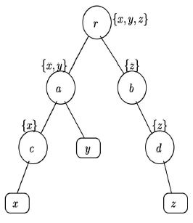
2. Subscription Management
EmdTree_{r}
  Based on underlying DHT links

Slide 22
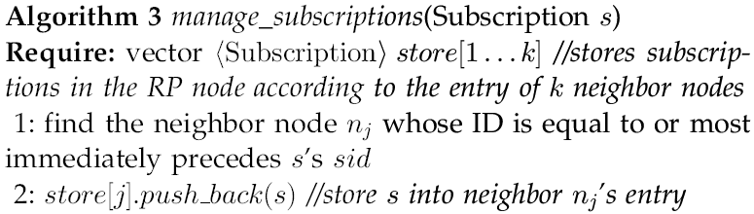
2. Subscription Management
Where to store Subscription “s” ?
  Whose node ID is equal to or most immediately precedes’s sid
Notes:
簡單來說，就是將資料存在訂閱者的祖先上面，因為背後其實是一個EmbeddedTree的架構。

Slide 23
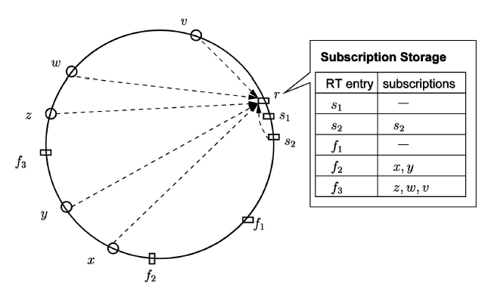
2. Subscription Management
Reducing the number of messages across the system.

Slide 24
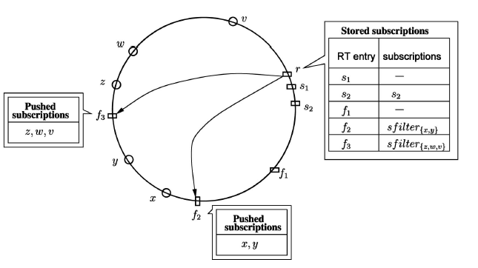
2. Subscription Management
One-Hop subscription
  Summary filter: push away the subscription
Notes:
會這樣作有兩個主要的目的，一是分擔RP node的load，已達到load balance的目標。因為前面有看到，某些RP node將會負責較多的subscription，因此需要此機制來分散負擔。
是利用DHT table維護的封包夾帶是否願意負責部份的subscription的資訊，來達到此功能。
另一點是為了要減小RP node傳送的訊息大小，此時就不會包含node id的資訊，這在event delivery時，可以減少bandwidth的cost。

Slide 25
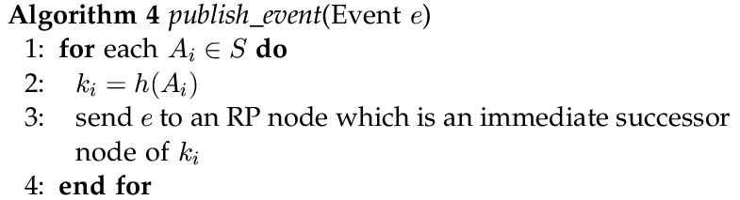
3. Event Publication and Matching
Publish Event
  Directs the event to all the RP nodes
Notes:
可以利用Chord routing protocol或是直接點對點傳送event到RP node ，點對點的狀況是當publish node有將負責的RP node IP catch起來

Slide 26
3. Event Publication and Matching
Matching event

Slide 27
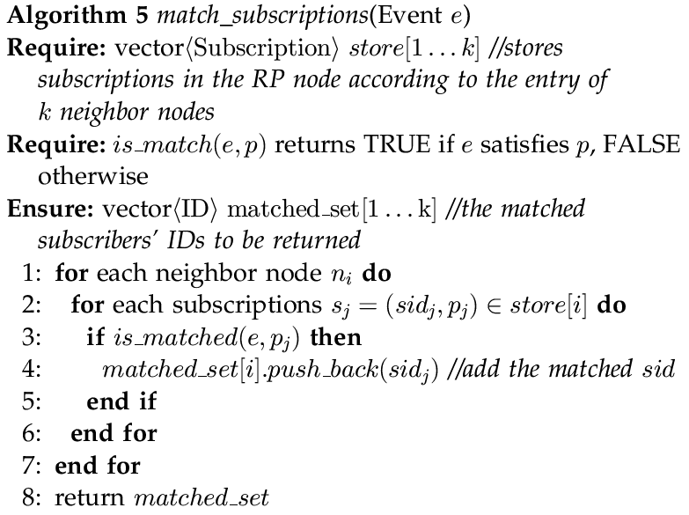
Notes:
再搭配前面所提出的one-hop subscription push，可以減少RP node在做matching的負擔。而後面還會提出attribute partitioning來更進一步的分散matching load(利用增加RP node的數量)。

Slide 28
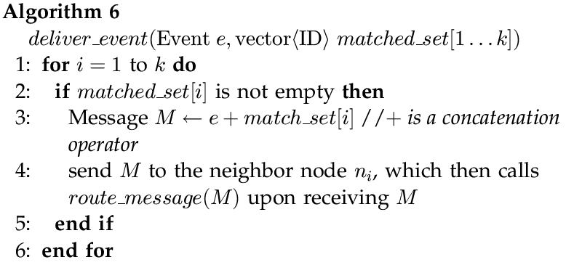
4. Event Delivery

Slide 29
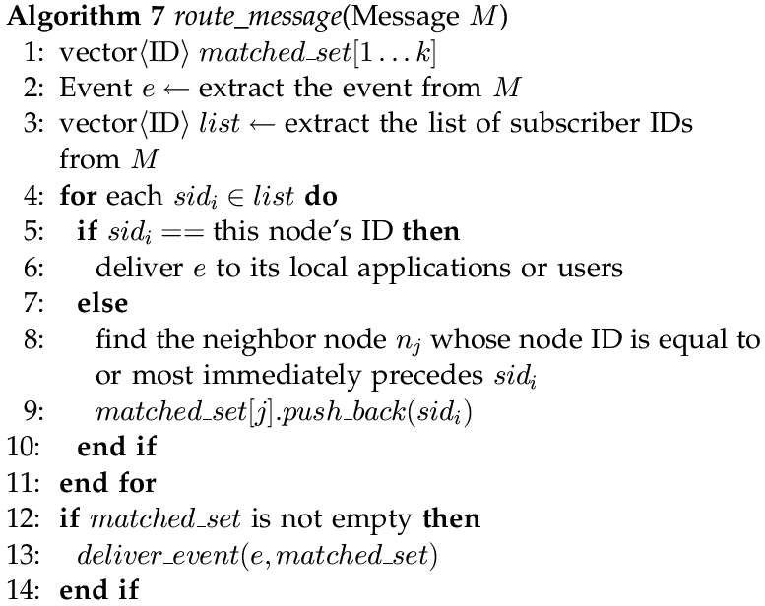

Slide 30
Load Balancing
Attribute Partitioning
  EX: Temperature [0, 25], (25, 50], (50,75], (75, 100]

Slide 31
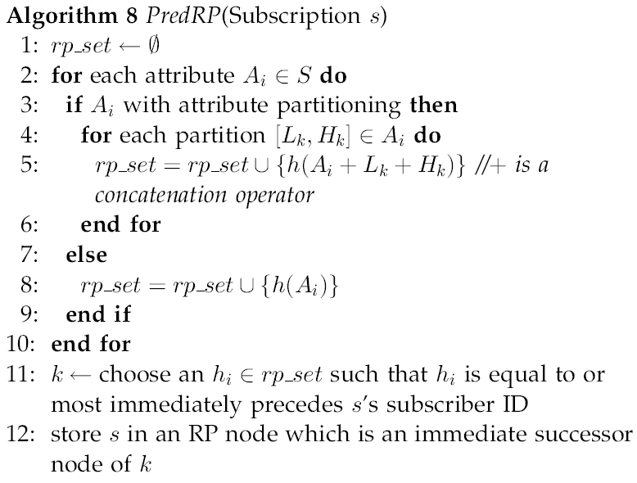

Slide 32
Scaling to Number of Event Attributes
What about the number of RP nodes is very large?
  Envisioning the RP nodes as the subscribers of the event publish node.
Notes:
當event產生時，要送給RP node去作match的工作，當數量小的時候，只需要利用catch裡面的資料，就可以取得RP node 的Address。但是當網路節點數量多的時候，點對點傳輸就顯得相當不實際也很沒有效率，幸好，Frrry提供的方法就不會有這種問題，我們只需要想像，RP node是subscriber，用一樣的方法就可以將event送到RP node。

Slide 33
Outline
Introduction
Related Work
Background : CHORD
System Design
Discussion
Alternative Design
Evaluation
Conclusion and Future Work

Slide 34
Discussion
Large network
  Subscriber ID list will be long
    Spit of the matched subscribers O(logN)
    Recursively
  By using attribute partitioning
  One-hop subscription push
Adaptability to Other DHTs
  Pastry, Tapestry, and CAN

Slide 35
Outline
Introduction
Related Work
Background : CHORD
System Design
Discussion
Alternative Design
Evaluation
Conclusion and Future Work

Slide 36
Alternative Design
Install the subscription on all the peer nodes along the dissemination paths from the RP node to their subscribers.
Abandoned
  Limitation
    Storage space、Extra processing time
  Subscribing/Unsubscribing
    Need to traverse O(log N) more nodes and messages
Notes:
從RP node到subscriber路徑上所有的nodes都存放subscription資訊，當event發生時，RP node只需要算出該把event交給誰，然後把event送出去就可以了，因此在此種情況下不需要傳送subscriber id list。
缺點
當高訂閱、解除訂閱的時候會造大量的traffic，因為要更新路徑上所有點的資料

Slide 37
Outline
Introduction
Related Work
Background : CHORD
System Design
Discussion
Alternative Design
Evaluation
Conclusion and Future Work

Slide 38
Evaluation
On top of “p2psim”
  A discrete-event packet level simulator
1024 nodes
Average round trip time: 198ms
100 and 10000 subscriptions
10000 events

Slide 39
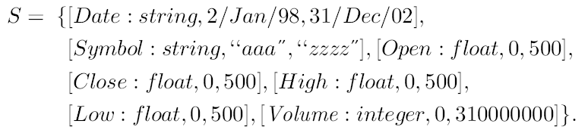
Evaluation

Slide 40
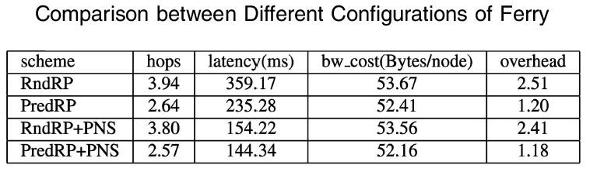
Evaluation
PNS: proximity neighbor selection
  Allows each Chord node to choose physically close nodes as routing table entries to reduce lookup latency
Notes:
PredRP經過Chord ring中較少的距離(RndRP也許會繞一整個ring)，PredRP可以避免送出重複的訊息

Slide 41
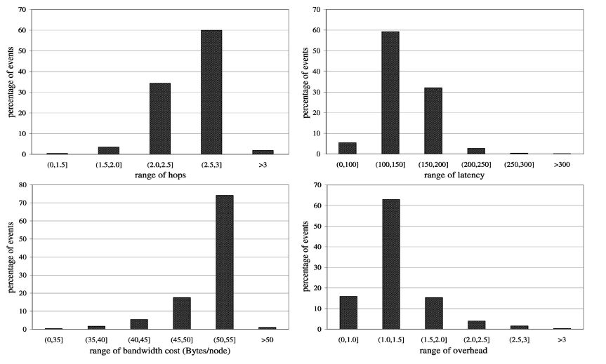
Evaluation
Notes:
百分之94.22 的event在2-3 hop內送達目標
百分之59.2的event在100-150ms內傳送到
大概每1.18個event就需要消耗52.16 Bytes的頻寬

Slide 42
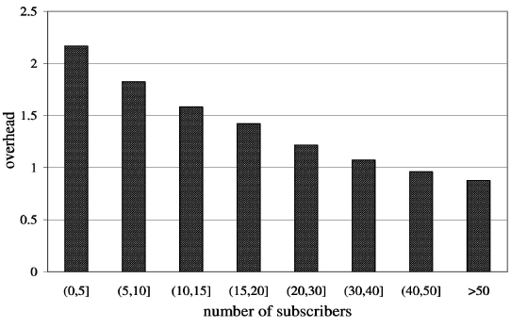
Evaluation
Notes:
Ferry可以再有大量的訂閱者的環境中，以很低的overhead來傳送event
因為使用PredRP創造出像是Grouping的觀念，以及他可以將資料Aggregate在一起

Slide 43
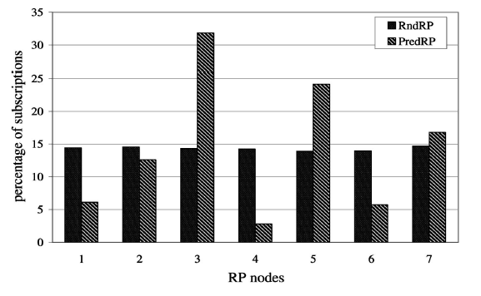
Evaluation
Notes:
RndRP的subscription較分散，PredRP產生較不平均的分佈，突顯出了採用one hop subscription push的必要

Slide 44
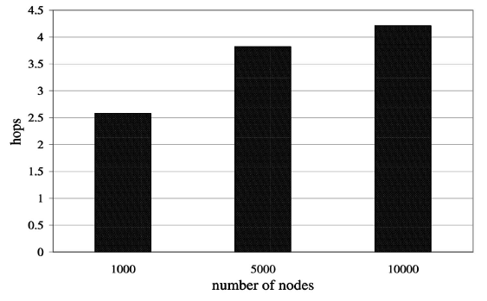
Evaluation

Slide 45
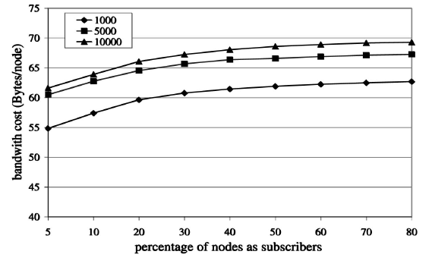
Evaluation
Notes:
當network變大，頻寬消耗跟經過的hop數量都是適度的增加，證明了Ferry在node數量極多的時候也適用。另外隨著訂閱的人數增加，頻寬的消耗也增加的十分緩慢，顯示出Ferry可以應付大量的訂閱。

Slide 46
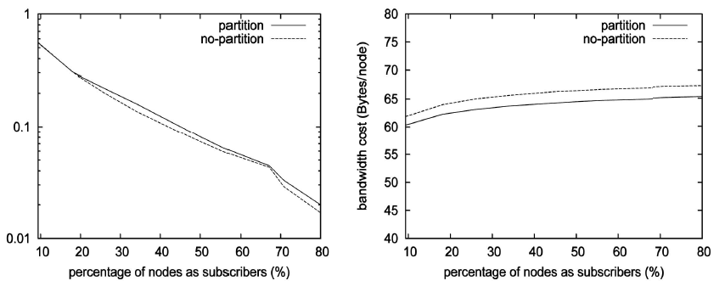
Evaluation
Notes:
Attribute partitioning會帶來一些overhead，但是相對的可以減少頻寬的消耗(因為送的ID List變小)

Slide 47
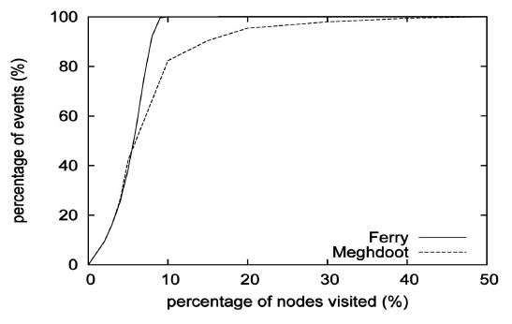
Evaluation
Notes:
在傳送event時Ferry很明顯比Meghdoot好，他只需要經過10%的節點

Slide 48
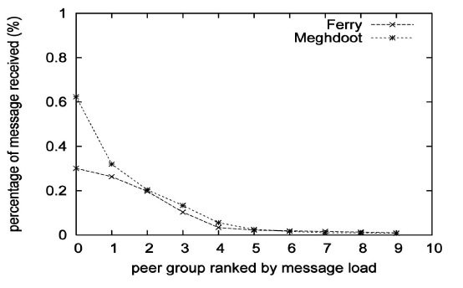
Evaluation
Notes:
將各個node分組，這邊可以看到Ferry一個群組中最多收到0.3%的訊息，很明顯比Meghdoot公平

Slide 49
Outline
Introduction
Related Work
Background : CHORD
System Design
Discussion
Alternative Design
Evaluation
Conclusion and Future Work

Slide 50
Conclusion And Future Work
First design wisely exploits the underlying DHT overlay structure to build an efficient and scalable platform for content-based pub/sub services.
  Can deliver events to various numbers of subscribers.
  Can support large number of event attributes.

Slide 51
Conclusion And Future Work
Investigate the reduction of the DHT maintenance cost in terms of bandwidth by piggybacking the DHT link maintenance messages onto the event delivery messages.
How cooperative peer nodes have to be in Ferry.
Comparison

Slide 52
The End

